Slide 1

My Teen - Tips for Parents
Hints and suggestions for supporting your child.

Slide 2

What can parents do to help support a healthy lifestyle for their teen?
Here are some suggestions:
KEEPING A ROUTINE
Help them create some structure to their day – it is important to get up at a reasonable time and not go to bed too late, to get some fresh air each day and do some physical activity.
Here is an example of a Daily Planner you could use with you child to create and keep up some routines:

Slide 3
Encouraging your child to help create their own daily goals and activities could be a good way to keep them motivated. Also, letting them know that the family is “in it together” and creating a plan for each member of the household could be beneficial.

Slide 4
2. COPING WITH CHANGE AND WORRY
“The most important thing is to reassure your teenager that they will cope with the changes. It is really good to have more practice with change, as everyone faces change throughout their lives. Those who handle it best – who can ‘go with the flow’ - will often save themselves a lot of unhappiness and heartache.”
- Dr Hayley Van Zwanenberg, Priory Child and Adolescent Psychiatrist.
You may want to encourage the use of a “Worry Jar” as this can be a great outlet for anxious thoughts and worries. Read on for a guide to creating your very own…

Slide 5
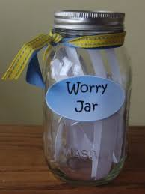
Making a Worry Jar/Box
Choose a box or container. If you’re using a cardboard box, seal down the lid using sellotape and then use scissors to make a slit in the top that’s big enough to post slips of paper through – so that it works like a post-box. If you’re using a jar, make sure you can open and close the lid.
Decorate the box together, using things like felt tips, paints, tissue paper, stickers and glitter.
Label the container the ‘Worry Jar’ (or box).
Agree where to store the box, asking your child if a particular place feels right for them. Avoid keeping it in or next to their bedroom. They might want to hide it inside a cupboard somewhere in the house. Or, if they tend to worry about things that are the parents’ job to manage, it could help to keep the box in your bedroom.
Tear up some slips of paper and leave these next to the box with a pen.
(Guidance from Youngminds.org.uk).

Slide 6
Using Your Worry Jar/Box
Agree a time when you will use the worry box together. Avoid using the box just before bedtime, so your child isn’t worrying whilst trying to sleep.
Ask your child to write or draw anything they’re worrying about on the slips of paper
When your child has finished, ask them to share each worry with you and discuss them. It can be helpful just to listen and acknowledge the worries, although you can talk about solutions or ways to cope if you want to.
Ask your child to fold up the piece of paper and post it into the box.
Recognise together that the worries have been given to the box and can be left in there. Agree not to talk about them any more that day – the box has got them and they can be let go.
Close the box and put it away.
Spend some time talking about some positive thoughts to remind your child to try to focus on the good things.
(Guidance from Youngminds.org.uk).

Slide 7
3. LOOKING AFTER PHYSICAL HEALTH
Physical health directly affects our mental health and wellbeing. It is important to try to encourage your child to exercise and keep a balanced diet, despite how easy it is to fall out of good habits.
You could encourage a healthy diet by including your child in meal planning and preparation – read on for some fun and healthy recipe suggestions.

Slide 8
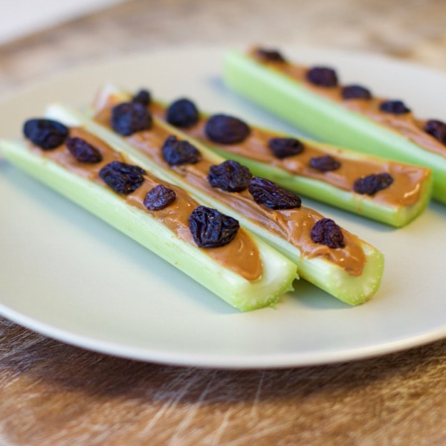
Ants on a Log
3 simple ingredients, 3 simple steps!
Ingredients:
Celery
Peanut Butter (or Cheese Spread if preferred)
Raisins
How To Prepare:
Thoroughly rinse your celery stalks, cutting off any dried ends.
Spread about two tablespoons of peanut butter/soft cheese
along the centre of each stalk.
Add your ants!

Slide 9

Healthy Tortilla Pizza
Ingredients:
1x 8-inch whole-wheat or plain tortilla wrap
1 tablespoon of olive oil
1x fresh tomato
½ a red onion
3 tablespoons of grated cheese (preferably mozzarella)
2 cups of mixed salad
Herbs and balsamic vinegar to taste
How to Prepare:
Lay your tortilla wrap on a non stick or foil lined oven tray.
Brush lightly with oil.
Top with tomato, onion and cheese.
Toast in the oven until cheese is melting and tortilla is starting to crisp (7 – 9 minutes). Remove and cut into slices.
Season with herbs as desired.
Drizzle a little oil and balsamic vinegar over the salad and serve alongside your pizza.

Slide 10
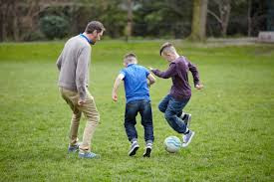
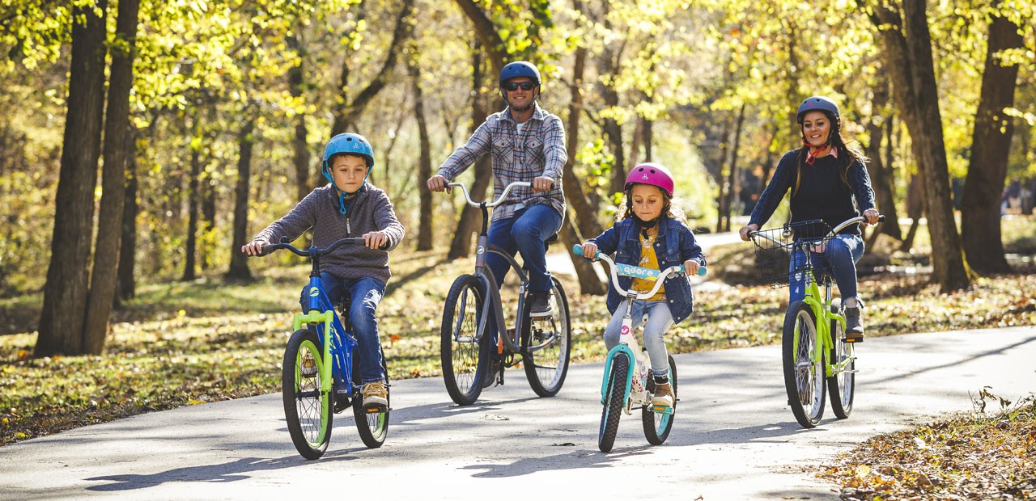
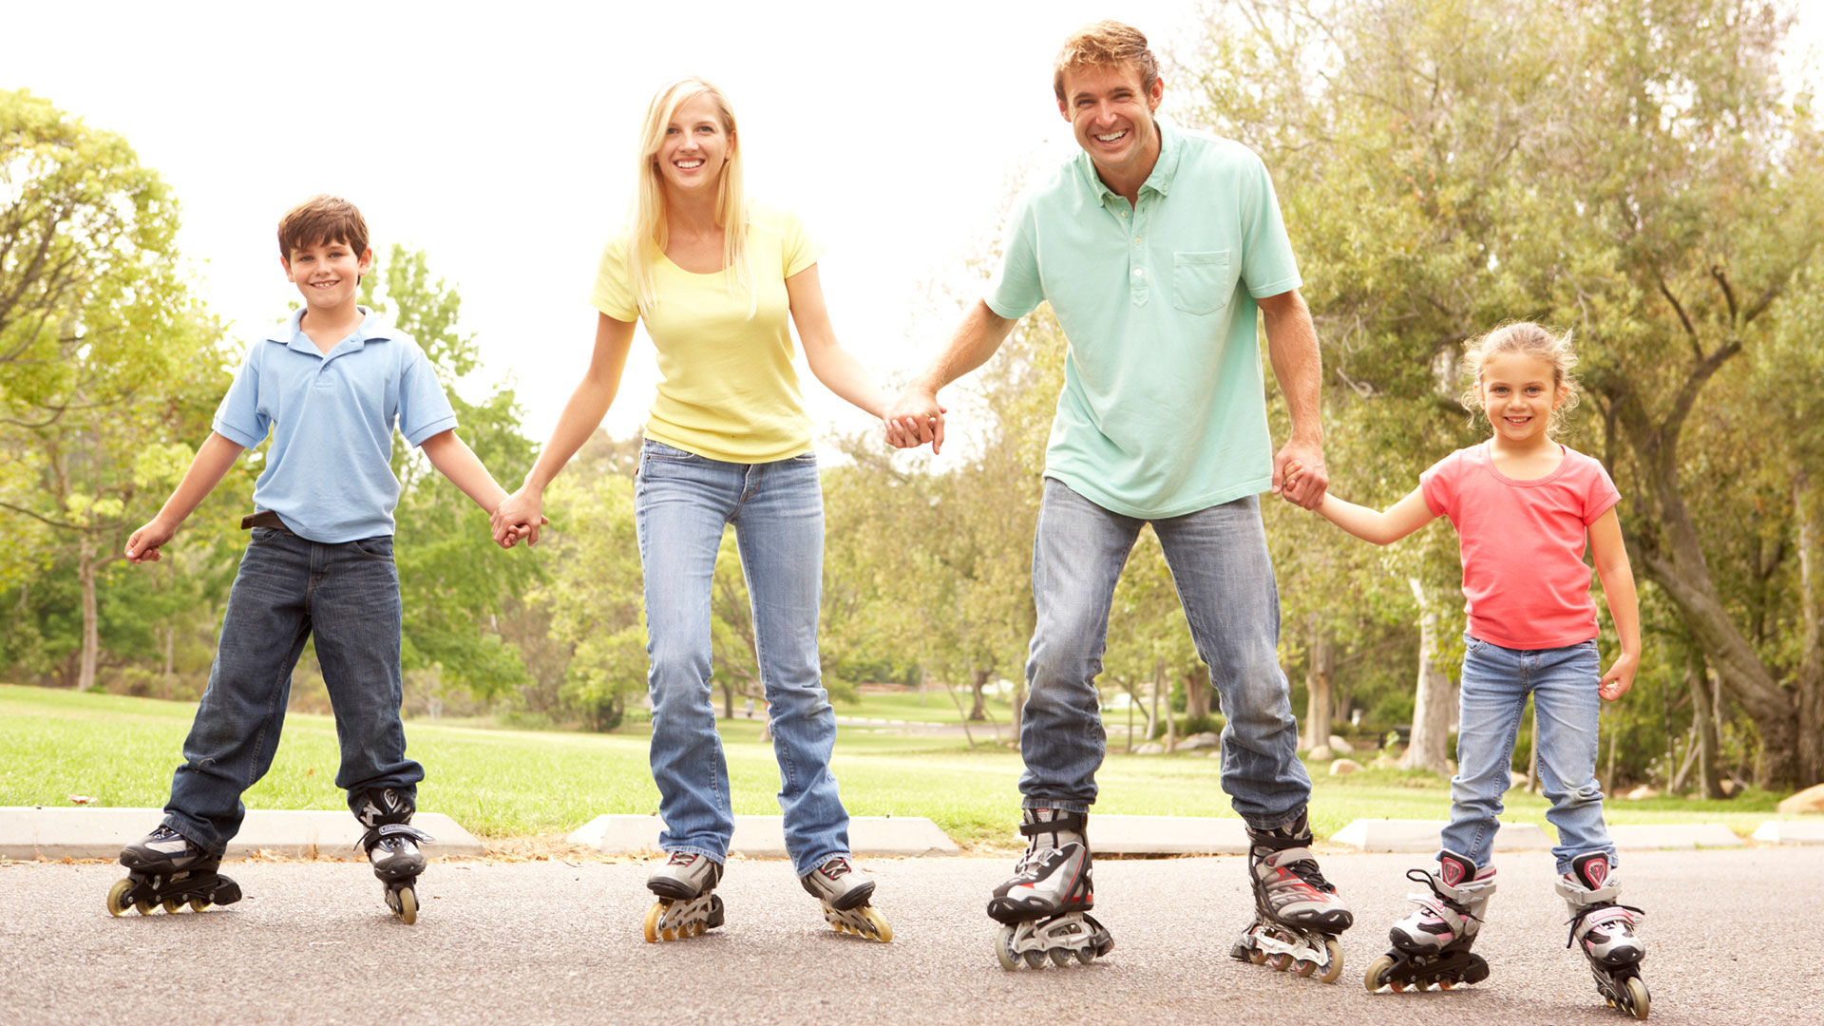
Exercising
Motivating a teenager to do some physical activity can be difficult.
Why not suggest doing something together or with the whole family?
Here are some useful links to some activities:
https://darebee.com/workouts.html
https://www.youtube.com/channel/UCAxW1XT0iEJo0TYlRfn6rYQ

Slide 11
4. STAYING CONNECTED
It important to stay connected with friends and loved ones as social interaction is proven to be of great support and comfort. Perhaps your child can make use of the internet to communicate with friends and family via social media and messaging apps. As a parent, it is good to monitor this and make sure your child does so safely.
Tips for Staying Safe Online
Never accept friend requests/follows etc from someone you or your child doesn’t know in “real life”.
Check yours and your child’s privacy settings – it is safer to limit your content to friends/followers only.
Always monitor your child’s activity online and report any concerning contact.
Encourage your child never to share their log in details or any personal details about themselves with others online.

Slide 12
5. MAKING SURE YOU’RE UP TO THE TASK
As a parent, it is important to be mindful of your own wellbeing and take some time to make sure you’re looking after yourself as well. It is much harder to function as a parent if you are feeling overwhelmed and stressed out.
Here are some ideas for self care for parents:

Slide 13
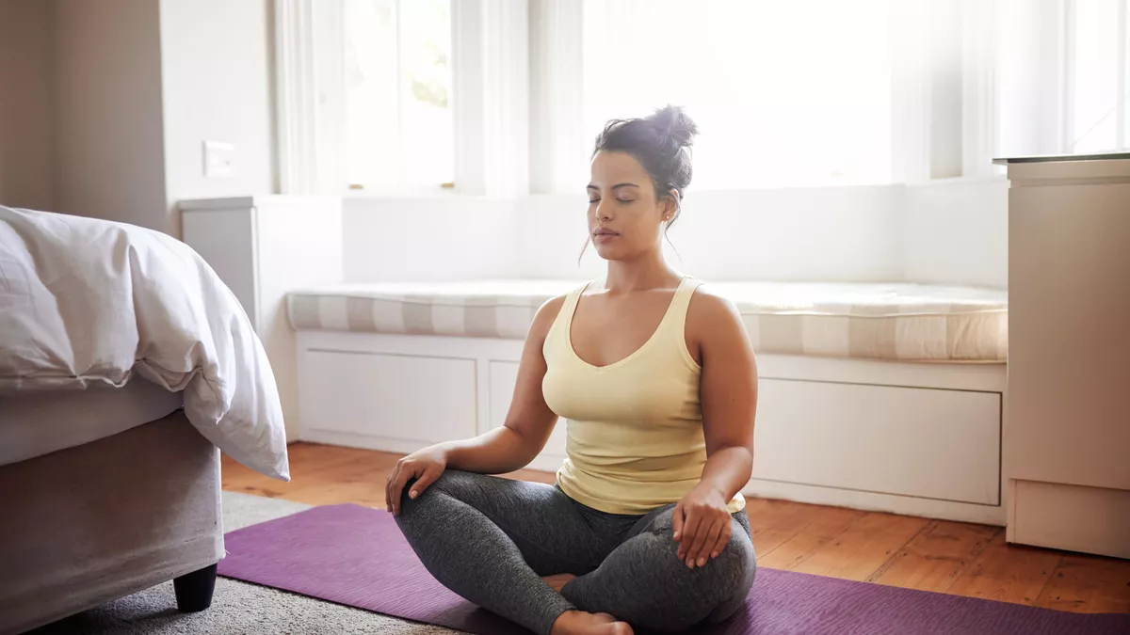
Meditation
This can be done by yourself or there are lots of guided sessions available online
(try YouTube or Google). Meditation can create calm and refocus your mind away from
overwhelming thoughts, and sessions can be as long or short as you like. See below for a guide to a
5 minute meditation session.
Focus on a five-count breath:
Slowly inhale from the belly.
Then into ribs.
Then into chest.
Up into crown of the head.
Then gently hold the breath for the fifth count.
Repeat as desired.

Slide 14

Engage Your Senses
It’s hard to be in the moment when life is busy. Engaging your senses is a good way to relax and find a sense of calm. Light a scented candle, take a hot bath, listen to soothing sounds. Engaging one or more of your senses can be a simple but effective way to take a time out from the hustle and bustle.

Slide 15


Listen to Music or Your Favourite Podcast
This can be done as part of your normal daily life and could help to
ease the stress of housework and everyday chores.

Slide 16






Further Resources
Remember to reach out if you or your child are struggling. There are many resources available online and via telephone, and your local GP can provide support and signposting.
www.kooth.com
Phone 116 123 or visit www.samaritans.org
www.familylives.org.uk
www.youngminds.org.uk
www.anxietyuk.org.uk
Phone 0800 58 58 58 or visit
www.thecalmzone.net

