Slide 1


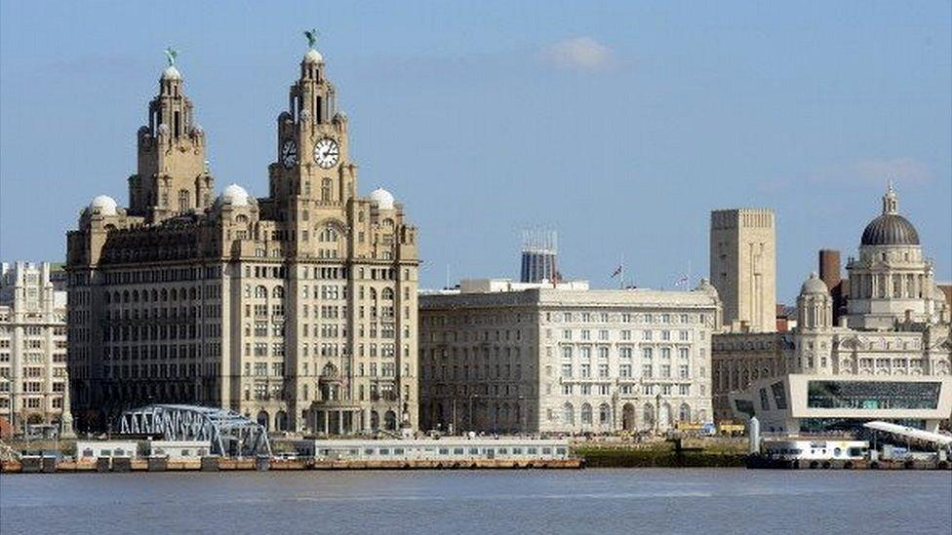

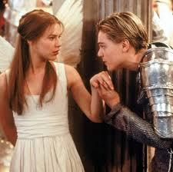
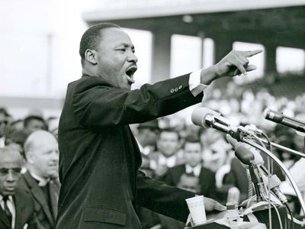


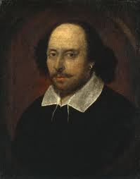
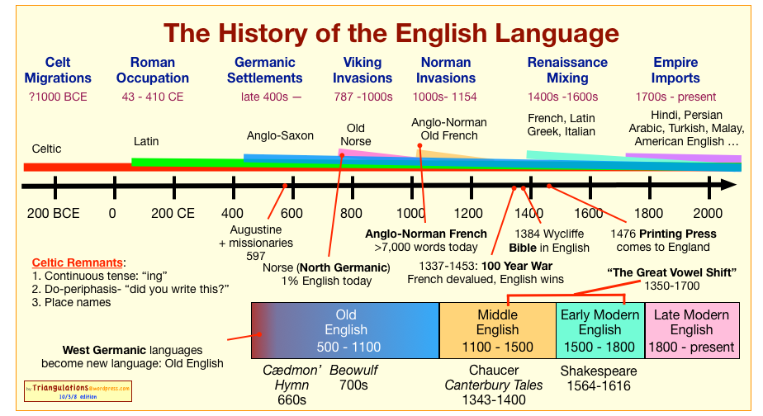

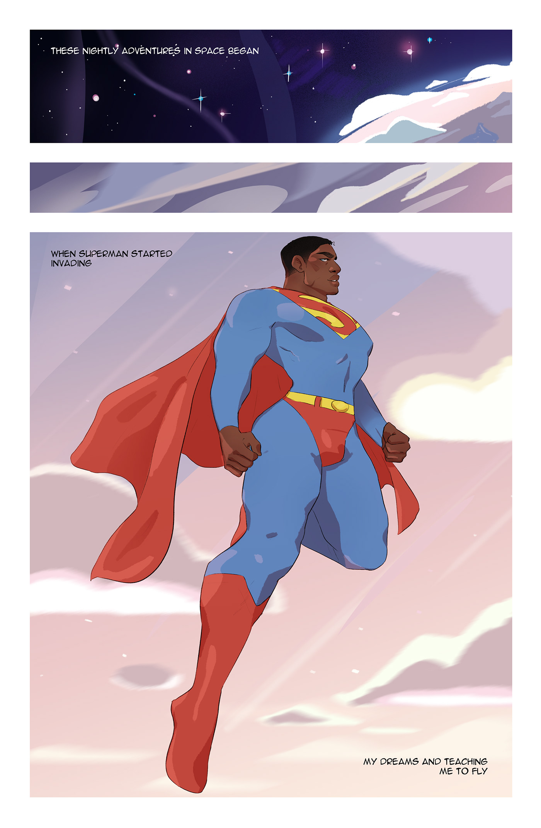
HT5- Macbeth. Evaluating key themes, the tragic hero and critical analysis.
HT6- Macbeth.Evaluating Shakespeare’s methods.
HT4- My Liverpool. Evaluating the impact of historical events on the traditions of Liverpool. Writing their own article on Liverpool.
HT3- Poetry: Evaluating the use of poetic devices
HT2- Drama Evaluating the conventions of drama.
HT1-Fiction Reading: Western Lane, Evaluating symbolism and writer’s craft
Year 9
HT6- Romeo and Juliet
Analysing the use of Shakespeare’s choices in the tragedy.
HT5- Language Change
Analysing the influence of social ideas on language change.
HT4- Rhetoric and powerful speeches
Analysing the effect of rhetorical devices to write a range of non-fiction fiction forms.
HT3- Poems from different cultures
Analysing cultural context on the poetic voice.
HT2- Gothic Literature
Analysing the use of the conventions of the gothic – setting, characterisation.
HT1 The Pearl
The effects of symbolism and the use of similes, metaphor and personification.
Year 8
HT5- The history of the English Language
HT6- Introduction to Shakespeare
Understanding Shakespearian context, the conventions of tragedy and villains.
Understanding language change through invention, invasion and the internet.
HT4 Transactional Writing
Persuasive writing techniques about an environmental campaign.
HT3- Seminal poets
HT2- Short stories
Understanding form, poetic structure and and the poetic voice.
The conventions of short stories and the concept of a moral.
HT1- Prose Where The River Runs Gold
Year 7
Understanding symbols, similes metaphors and understanding inference.

